Slide 1
Week 9

Slide 2
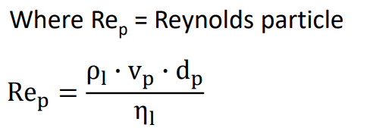
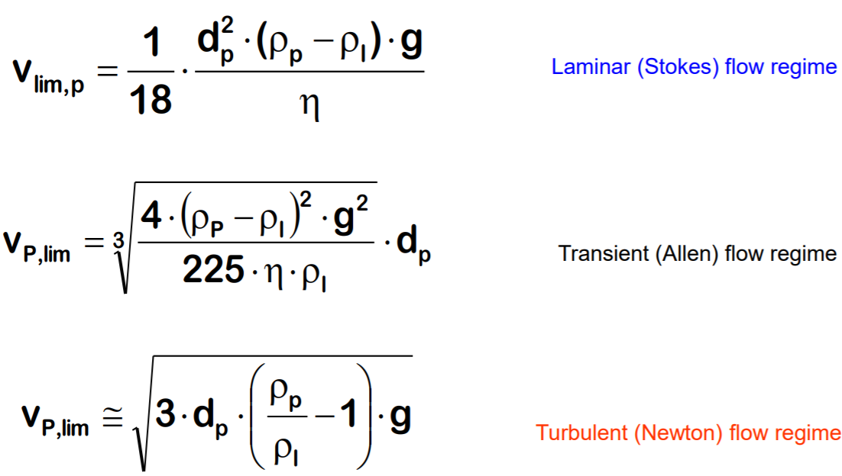
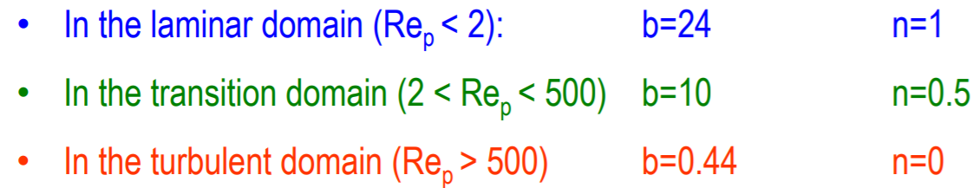
Exercise 2.1: Calculation of settling velocity
1.Calculate the terminal settling velocity in water at 20 °C for the particles below, using the appropriate model/flow regime (proceed iteratively if needed).
The properties of water (at 20°C) are: ρ = 0.9982 g/cm3， η = 1.0 mPa·s
Particle type | Diameter [m] | Density | V_{lim,p} | Re | V_{lim,p} (2) | Re (2) | V_{lim,p} (3) | Re (3) | Flow regime
 |  | [kg/m3] | [m/s] | [-] | [m/s] | [-] | [m/s] | [-]
E. coli | 1.20E-06 | 1010 | 9.25E-09 | 1.11E-08 | *** | *** | *** | *** | laminar
S. cerevisiae | 6.00E-06 | 1010 | 2.31E-07 | 1.39E-06 | *** | *** | *** | *** | laminar
Microcarrier | 1.50E-04 | 1020 | 2.67E-04 | 4.00E-02 | *** | *** | *** | *** | laminar
Seasand | 4.00E-04 | 2600 | 1.40E-01 | 5.57E+01 | 6.55E-02 | 2.61E+01 | *** | *** | transient
Lead shots | 1.50E-03 | 11400 | 1.27E+01 | 1.91E+04 | 8.55E-01 | 1.28E+03 | 6.78E-01 | 1.02E+03 | turbulent
Particle | Diameter [μm] | Density [g*cm-3]
E. coli | 1.2 | 1.01
S. cerevisiae | 6.0 | 1.01
Microcarrier | 150 | 1.02
Seasand | 400 | 2.65
Lead shots | 1500 | 11.40

Slide 3
2. What would be the impact of a temperature increase on the settling velocity?
A temperature increase will lead to a reduction in the viscosity of the liquid and to a decrease in its density. The latter will however lead to an increased density difference since the density of the solid is most likely not affected by temperature.
Both changes go in the same direction and contribute to an increase in terminal sedimentation velocity.
See for example at 60°C:
Density H2O (60°C) = 0.9832 g*cm-3
Viscosity H2O (60°C) = 0.4665 mPa*s
Hence, vlim,p for S. cerevisiae would increase from 2.31·10⁻⁷ m/s at 20 °C to 1.13·10⁻⁶ m/s at 60 °C
Particle type | Diameter [m] | Density | V_{lim,p} | Re
 |  | [kg/m3] | [m/s] | [-]
S. cerevisiae r.t | 6.00E-06 | 1010 | 2.31E-07 | 1.39E-06
S. cerevisiae 60 C | 6.00E-06 | 1010 | 1.13E-06 | 1.42E-05

Slide 4
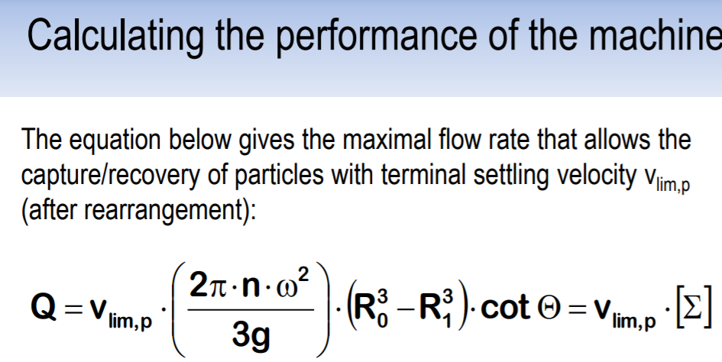
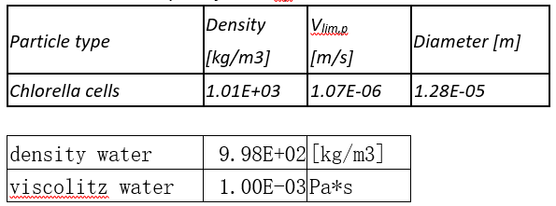
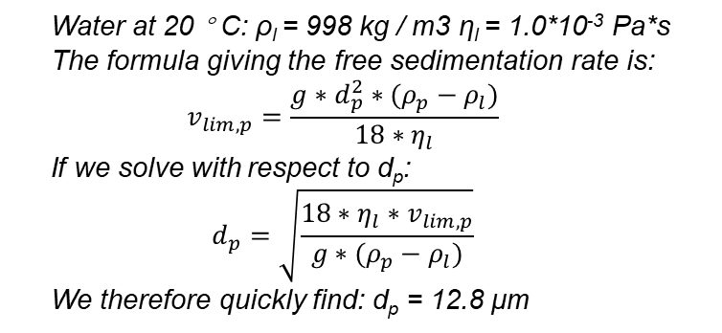
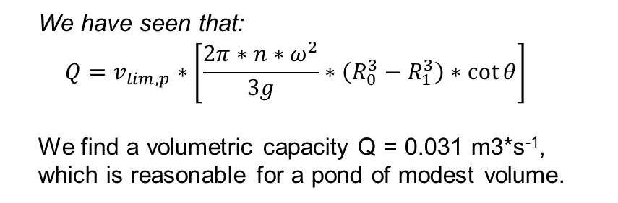
Exercise 2.2: Average yield for a series of steps
Chlorella cells are grown in an open pond and this biomass needs to be harvested using a disk stack centrifuge. The terminal settling velocity of the cells in water at 20 °C, v_{lim,p}, has been measured and is equal to 1.07*10⁻⁴ cm/s. The flow is laminar.
The centrifuge has 80 disks with an angle of 40° from the vertical. These disks have an external radius of 15.7 cm, while the internal radius is 6 cm. It is planned to work at 6000 rpm.
Estimate the equivalent diameter of the cells if their density is 1.01 g*cm⁻³
Calculate the volumetric capacity of the centrifuge under the above-described working conditions
Water at 20 ° C: ρ_{l} = 998 kg / m3 η_{l} = 1.0*10⁻³ Pa*s
The formula giving the free sedimentation rate is:
$$v_{lim,p}=\frac{g∗d_{p}^{2}∗(ρ_{p}−ρ_{l})}{18∗η_{l}}$$
If we solve with respect to d_{p}:
$$d_{p}=\sqrt{\frac{18∗η_{l}∗v_{lim,p}}{g∗(ρ_{p}−ρ_{l})}}$$
We therefore quickly find: d_{p} = 12.8 μm
We have seen that:
$$Q=v_{lim,p}∗\left[\frac{2π∗n∗ω^{2}}{3g}∗（R_{0}^{3}−R_{1}^{3}）∗\cot{θ}\right]$$
We find a volumetric capacity Q = 0.031 m3*s⁻¹, which is reasonable for a pond of modest volume.

